Slide 1



Challenge to Triumph:
Exploring Real-World High Availability in SQL Server Environments
Harry Aujla – Director of Partner Alliances
SIOS Technology Corp
Copyright © 2024 SIOS Technology Corp. All rights reserved.
Notes:
Introduce yourself.
Explain who SIOS are and our specialisms
Introduce the content and walkthrough of real world customer use case for SQL HA.
Session will take 15/20 mins.
Please defer all questions until the end of the session.

Slide 2




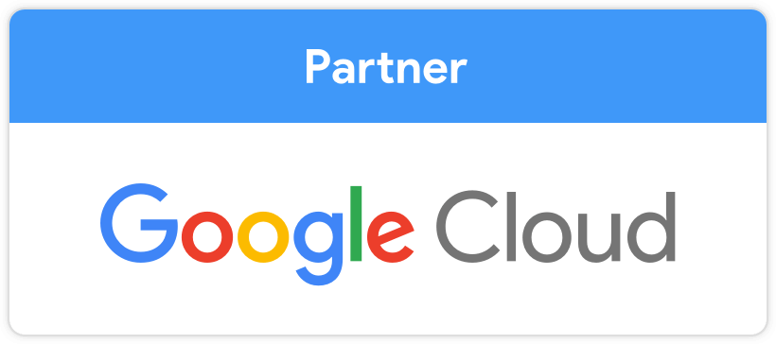







SIOS Technology Corp.
Founded in 1999
Headquarters in San Mateo, CA
Offices in
Across US
United Kingdom
Germany
Singapore
Japan
Key Alliance Partnerships
Notes:
General SIOS introduction:
Run through bullets.
Highlight our expertise in delivering SLAs for mission-critical apps and databases
Highlight that our success is driven by our partners.
Explain that although SIOS ca deliver HA over a wider range of apps and DB’s today’s focus is on SQL server, and an outline if the benefits of a SIOS HA solution for SQL in the form of a real-world use case.

Slide 3




Introduction
THE CHALLENGE AHEAD
Multinational Mass Media Conglomerate
Canadian HQ
Revenue $6B+
25,000+ Employees
Multinational News Agency
Tax & Accounting
Legal
Government
Financial & Risk
THE SOLUTION
THE Advantages
Notes:
Introduce the real-world use case (highlighting that we can’t name the customer).
Run through the bullets and highlight our work with the Tax and Accounting arm of the business.
Explain that we will run through the customer’s challenge, the solution, and the overall benefits gained.

Slide 4

The Challenge Ahead
Migration
Datacentre
AWS EC2
Digital Transformation
SQL estate
SQL Always-On
Aws Services
SQL Enterprise with Always-On Availability Groups running on high-end, multi-core servers
Expensive SQL Enterprise Licenses upon AWS FSx
Expensive AWS SQL Managed Services
Business decided to migrate their LoneStar & SQL infrastructure to AWS
Notes:
SIOS collaborates closely with the tax and accounting division of this customer organisation, which relies on a custom tax application named Lonestar.
Lonestar is supported by a substantial SQL server infrastructure, which was previously all housed on-premises across a mix of physical and virtualised environments.
Most of their availability needs were being met by SQL Always On Availability Groups, leveraging SQL Enterprise licenses, and they were running a larger number of hi-end, multi-core servers.
In line with many organisations, the customer recognised the potential benefits of a digital transformation of their IT infrastructure and sought to capitalise on cloud computing advantages.
They opted to migrate to AWS.
However, they did have some concerns about their future use of Always-On Availability Groups in AWS, due to the high level of licensing costs associated with SQL Enterprise, and also with the costs for running high-end, multicore AWS instances, in the same way they were operating on-premises.
They communicated to AWS their need for 99.99% high availability for the SQL infrastructure, and AWS proposed a couple of options:
Initially, AWS suggested they continued leveraging SQL Always-On Availability Groups and basing this upon an FSx storage infrastructure.
However, the customer hesitated due to the necessity of investing in further SQL Enterprise licenses. Given the evolving growth of the SQL infrastructure, purchasing new SQL Enterprise licenses would significantly inflate licensing costs.
They were also concerned about using FSx, as this introduced additional high costs in terms of the FSx consumption costs and the additional need for separate Windows and SQL teams to support FSx.
They also tested FSx and were not satisfied with it’s performance.
They also found that moving forward with SQL Always-On also presented some technical limitations in the number of databases it can support. Although the database limit for SQL Always-On is quite high (approx. 100 DB’s), it couldn’t support the future needs of the customer’s SQL infrastructure.
The alternative proposed by AWS was to have their SQL infrastructure fully managed as a service by AWS. However again, the associated costs of this option also raised concerns, especially given the scale of their infrastructure.
Unsatisfied with these options, the customer embarked on their own exploration for additional alternatives. After a brief period, they discovered SIOS as a potential solution by simply hitting our website.

Slide 5

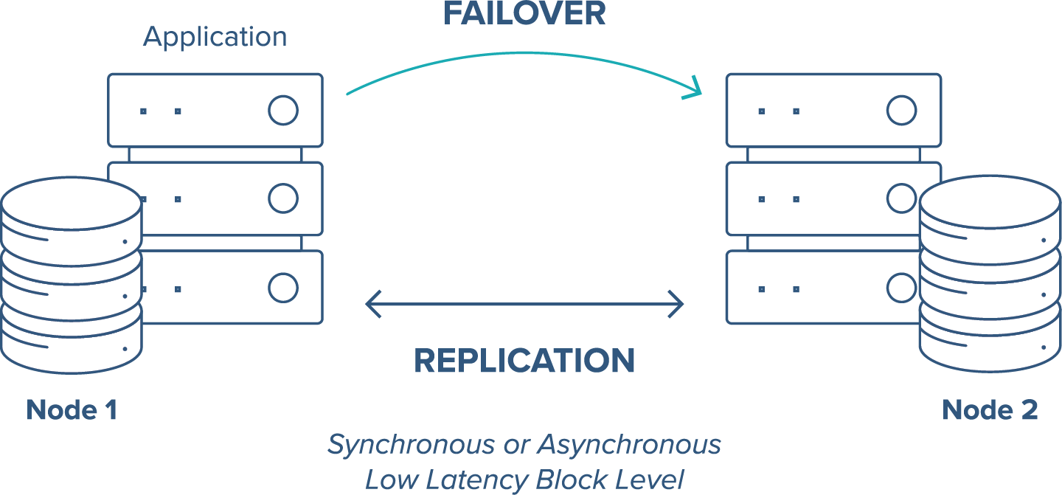
DataKeeper Cluster Edition
Notes:
DKCE overview and basic functionality.
No need for FSx.
Cheaper than FSx.
No need for larger multicore instances.

Slide 6
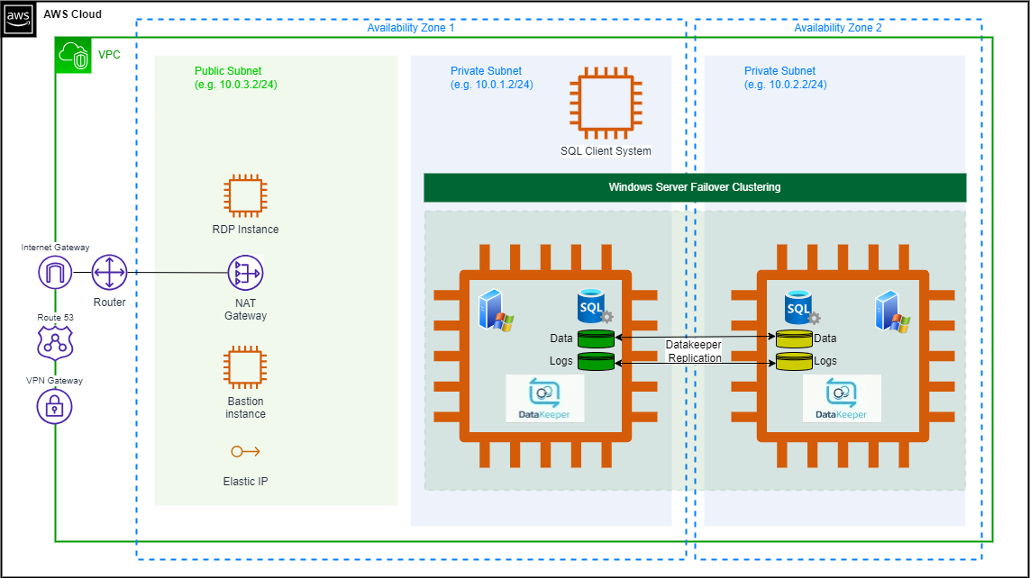
Implementation In Practice
Notes:
Describe how DKCE works in AWS.
Running approx. 300 cluster in this way.
Will speak in a moment about the kind of money this customer is saving in SQL licenses.

Slide 7

The Advantages
Infrastructure Agility
Protection for Unlimited No. of Databases
Award Winning Customer Service & Support
SIOS Now Part of Standardised SQL build
Drastic Reduction in SQL Server License Costs
Notes:
Automated deployments
DKCE was inserted into their automated deployment scripts as part of the standard SQL build.
Allowed for speedy deployments of pre-built instances as and when a BU needs SQL resources.

Slide 8

The Advantages
Infrastructure Agility
Protection for Unlimited No. of Databases
Award Winning Customer Service & Support
SIOS Now Part of Standardised SQL build
Drastic Reduction in SQL Server License Costs
Notes:
SQL AOAG is limited to 1000 DB’s so this meant they would have to horizontally spread their databases across a huge number of SQL AOAG clusters.
With DKCE, as there’s no limitation on the number of databases per cluster, this suited them as it meant they could minimise the number of clusters they needed to deploy.
Currently with DKCE, they are operating approx. 300 clusters at any given time across their infrastructure, but with SQL AOAG, they would have to be running many hundreds of more clusters, and thus would have been looking at some considerably higher costs.

Slide 9

The Advantages
Infrastructure Agility
Protection for Unlimited No. of Databases
Award Winning Customer Service & Support
SIOS Now Part of Standardised SQL build
Drastic Reduction in SQL Server License Costs
Notes:
Any good HA solution is only as good as the support that underpins it.
Customer was impressed with SIOS’s support satisfaction record of over 97%.
24/7 follow-the-sun support model.

Slide 10
The Advantages
Infrastructure Agility
Protection for Unlimited No. of Databases
Award Winning Customer Service & Support
SIOS Now Part of Standardised SQL build
Drastic Reduction in SQL Server License Costs
Notes:
Due to the infrastructure agility benefits highlighted earlier, SIOS has now become a core part of the standard AWS instance build for SQL server.

Slide 11
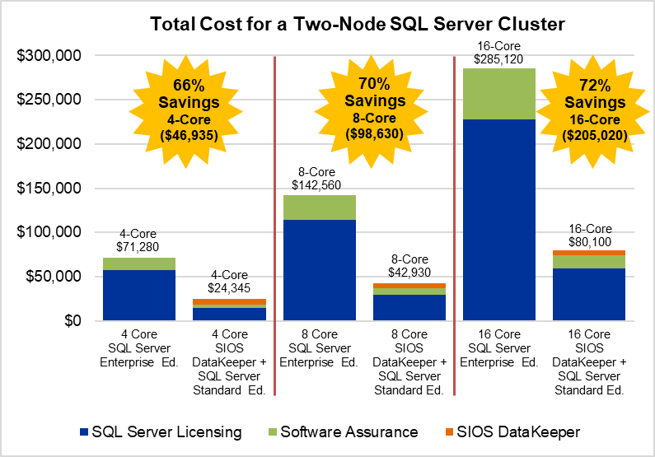
The Advantages
Infrastructure Agility
Protection for Unlimited No. of Databases
Award Winning Customer Service & Support
SIOS Now Part of Standardised SQL build
Drastic Reduction in SQL Server License Costs
Notes:
The headline benefit is related to the cost savings the customer has made since deploying SIOS.
SIOS has given them the ability to drastically cut their SQL server licensing costs by replacing SQL Enterprise and SQL Always-On, with SIOS DataKeeper and SQL Standard Edition, whilst delivering the same availability SLA of 99.99%
They also saved further costs by avoiding the need to deploy large multicore instances. In a physical environment, they were deploying 16 to 32-core servers, whereas in AWS, although they still running some 32-core instances, they managed to get most of the SQL estate to run on 8 to 16-core instances.

Slide 12

The Advantages
Notes:
This is a larger version of the same chart so it’s a bit more readable.
So switching to SQL Standard with DKCE, and once you also factor in software assurance and maintenance, the net result for most of our SQL customers is a cost saving of up to 70% on the SQL licensing estate.

Slide 13
SQL License Savings Comparison
SQL License Savings Comparison
SQL Enterprise x 32 cores | $40k
SQL Standard x 32 cores | $10k
Saving | 75%
SQL Enterprise x 16 | $640k
SQL Standard x 6 | $60k
Saving | 90%
Notes:
Let's relate this comparison back to our customer's specific situation.
What's noteworthy is that these figures provided are directly from the customer themselves and not generated by SIOS.
Recently, the customer embarked on a new project involving the deployment of new databases and clusters.
Initially, the plan was to look at SQL Enterprise and 32-core EC2 instance strategy which would have cost them $40k in SQL Enterprise licenses per cluster.
However, replacing SQL Enterprise with SQL Standard Edition, and adopting a SIOS approach, they estimated the SQL cost per cluster would be about $10k.
This reflects a substantial 75% reduction in SQL licensing costs.
Considering their new project, had they persisted with the SQL Enterprise approach, they calculated that they would require 16 new SQL Enterprise licenses totaling approximately $640k.
In contrast, with a SIOS strategy, not only did they save on SQL license costs, but they also realised that due to the absence of any number of database limitations with SIOS, they could streamline the horizontal distribution of databases to only 6 SQL Standard licenses, amounting to $60k. This translates to an impressive 90% reduction in SQL server licensing costs.
Clearly, the decision was a no-brainer for this customer. While we acknowledge that not all customers may achieve identical savings, as it depends on the scale of their SQL estate, we firmly believe that integrating SQL Standard Edition with DKCE will yield cost savings across the board. If you're interested in delving deeper into this subject, please feel free to reach out for a discussion.

Slide 14

Additional Choices
Windows
SANLESS Clustering for Windows Failover Clustering
DataKeeper Cluster Edition
Windows
Linux
LifeKeeper for Windows
LifeKeeper for Linux
Windows Clustering for non WSFC Use Cases
Linux Clustering for SQL
Notes:
So, let's wrap up with our final slide.
We've briefly discussed a customer use case involving DKCE and how it delivered significant SQL license cost savings for them.
DKCE relies on WSFC, but not all of our SQL customers utilise WSFC.
Some customers opt not to use SQL with WSFC due to various reasons.
This could be because they have front-end apps that aren't Windows cluster-aware or they may operate in non-Active Directory domains where WSFC isn't suitable.
However, this doesn't mean these customers can't benefit from HA provided by SIOS.
An alternative Windows clustering option we offer is known as LK-W.
LK-W functions similarly to WSFC, monitoring the entire server stack from the operating system to applications, databases, and networking.
It facilitates failover and recovery operations in the case of any faults. Like DKCE, it's powered by the DataKeeper replication engine for data synchronisation.
Furthermore, we have SQL customers interested in running SQL on Linux. For them, we offer LK-L, the Linux equivalent of LK-W.
If you're interested in learning more about these solutions, please visit our booth for further discussion.

Slide 15





Before We Finish
Reminders
Stand 11 (next to Gate 3)
Prizes – Star Wars Lego
SQLBits Famous Friday Night Party

Slide 16


Thank You!
Notes:
That brings us to the end.
Thank you very much for your time.
I’d be happy to address any questions at this time.

